Slide 1
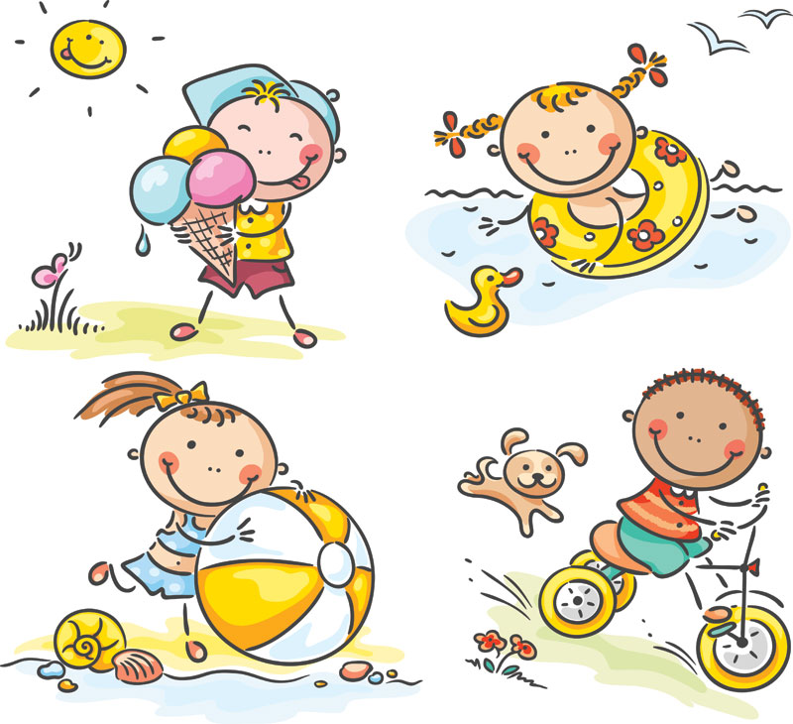
GRADE 4
UNIT TWO
My weekend
Lesson 5

Slide 2


Slide 3
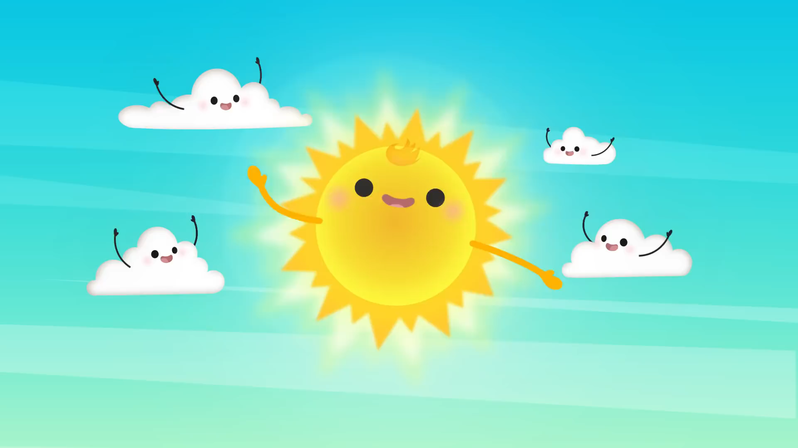

Slide 4
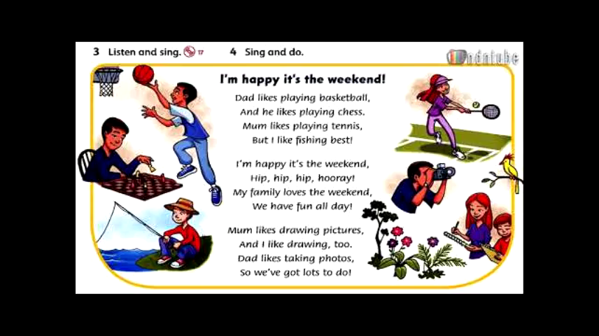

Slide 5

Listen and point

Slide 6
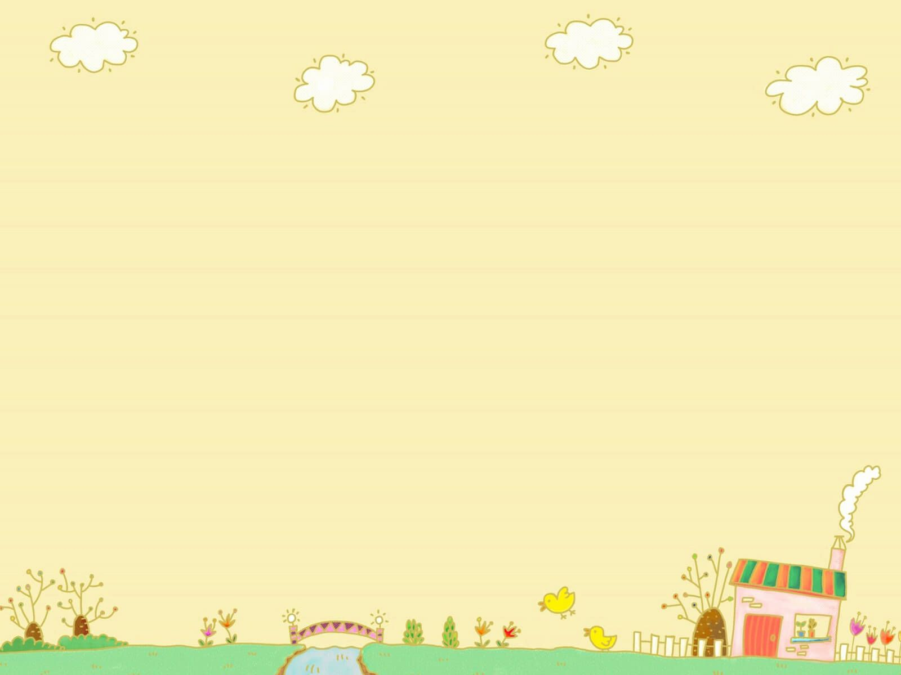
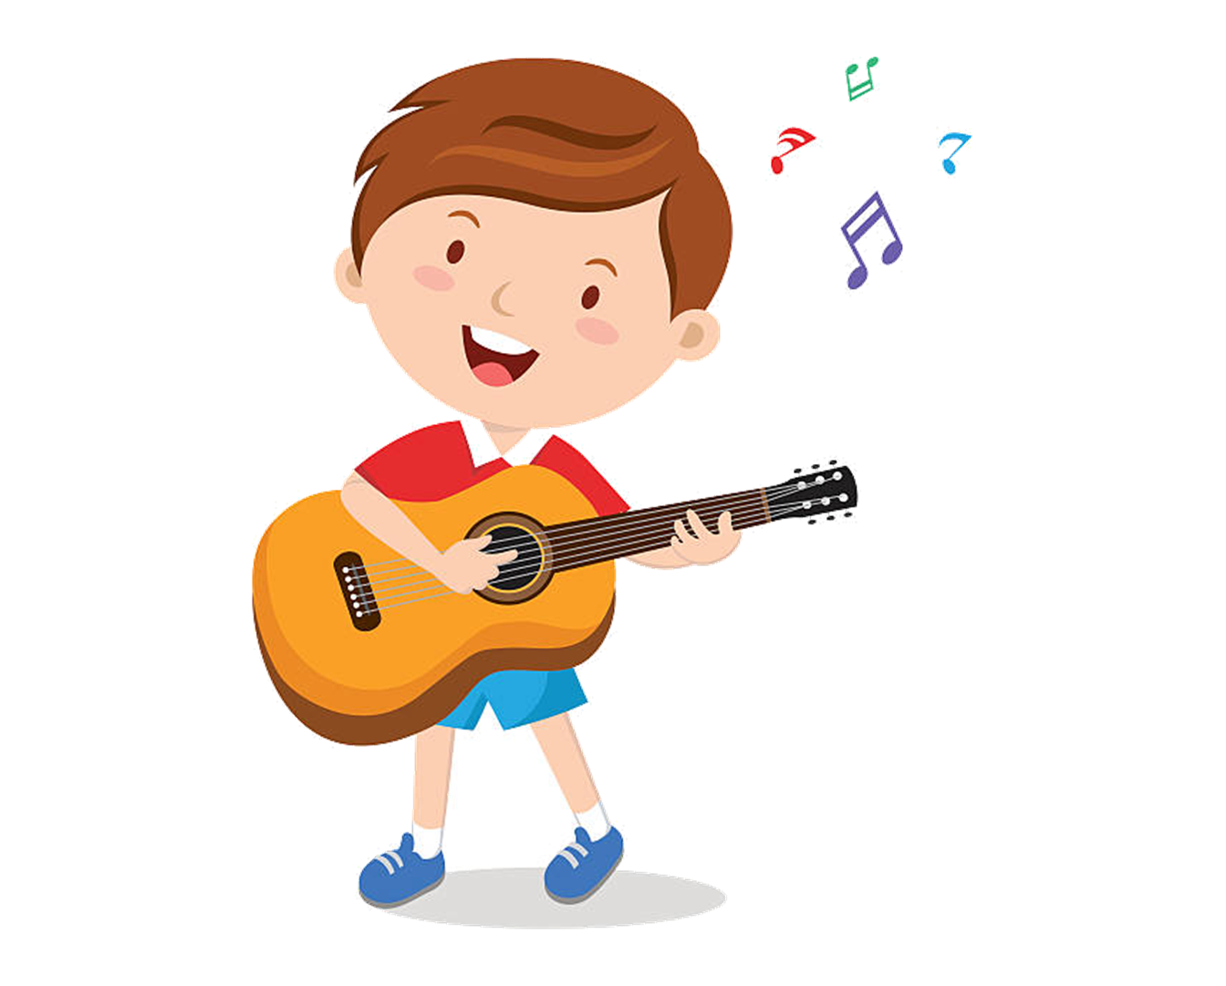

play the guitar

Slide 7
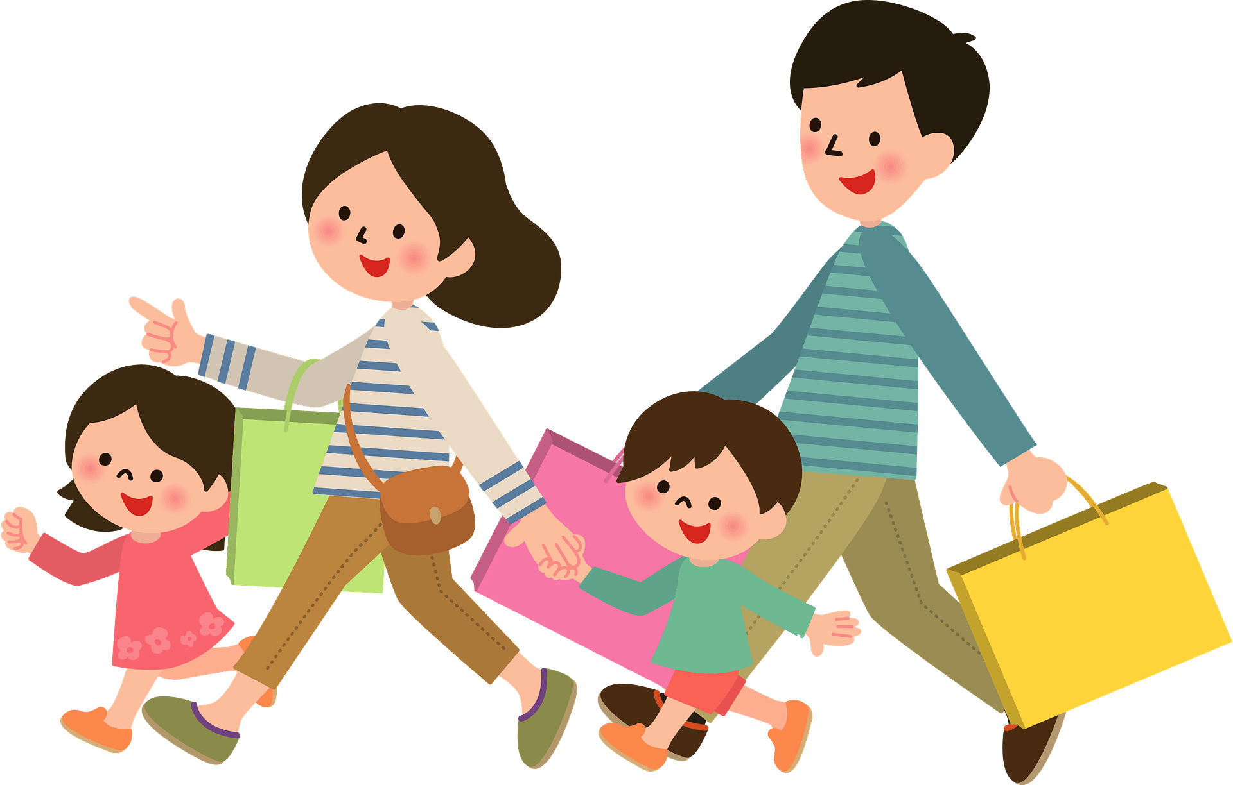
shop

Slide 8
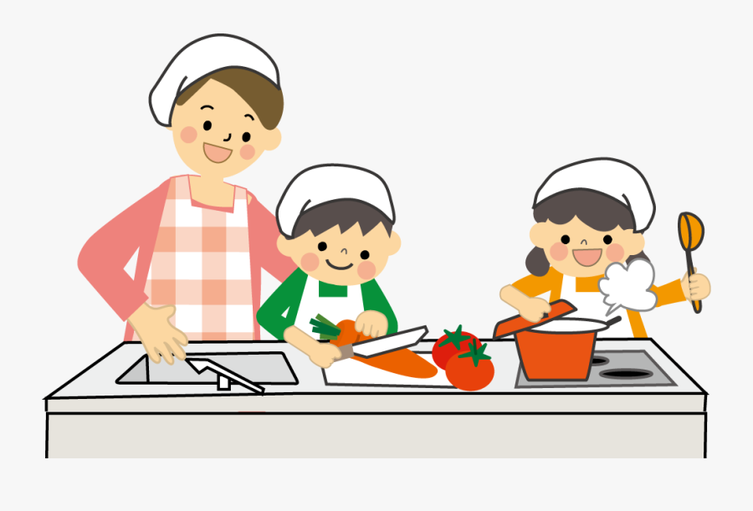
cook

Slide 9
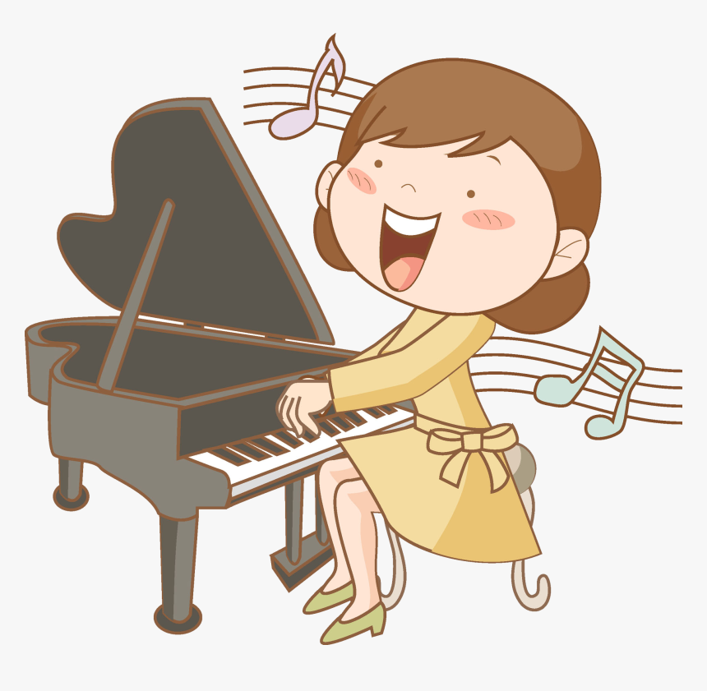
play the piano

Slide 10
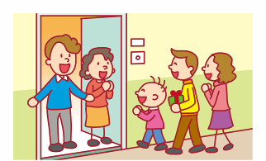
visit family

Slide 11

LISTEN and REPEAT.
OK.

Slide 12
play the guitar

Slide 13
shop

Slide 14
cook

Slide 15
play the piano

Slide 16
visit family

Slide 17
Listen and point

Slide 18
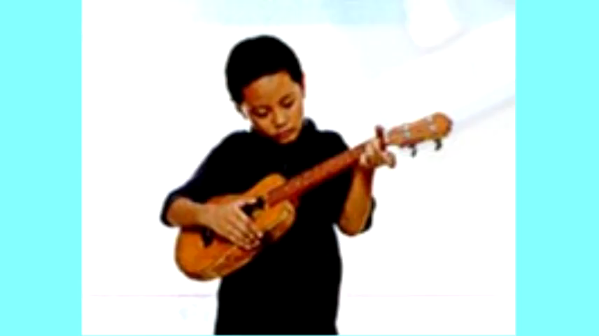

Slide 19

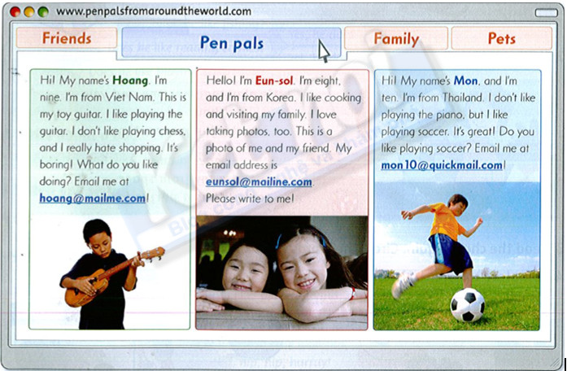
Task: read again

Slide 20
Answer these questions
Does Hoang like playing the guitar? _yes_ 3. Does Eun-sol like cooking? ____ 5. Does Mon like playing soccer? ____ | 2. Does Hoang like shopping? ___ 4. Does Eun-sol like taking photos? ___ 6. Does Mon like playing the piano? ___
No
Yes
Yes
Yes
No

Slide 21
GAME TIME.
Yeah.

Slide 22



1/ Hoang likes playing the guitar.
2/ Eun-sol is from Thailand.
3/ Hoang thinks shopping is boring.
4/ Mon likes playing the piano.

Slide 23
5/ Hoang is nine years old.
6/ Mon loves badminton because it’s great.
7/ Eun-sol likes cooking and visiting her family.
8/ Mon is from Brazil.

Slide 24
Task: choose a friend below and reply his/her email

Slide 25

Workbook time!!!

Slide 26



Slide 27
